Slide 1
App Development Lab
Android,Flutter and Flask

Slide 2
Mobile Application Development
Mobile applications eg: Big basket,country delight, wynk music etc.
There are 3 ways to develop mobile applications:
Mobile Apps
Android
-Android Studio
-Java & Kotlin
iOS
-Apple devices
-Swift
Flutter
-Hybrid apps
-Dart

Slide 3
Why Android?
World wide 71% people are Android users.
In India, among 1.1 Billion phone users, 700 Million are smart phone users, in which 95% perople are Android users.
This clearly shows the need of learning Android.

Slide 4
Basic Building Blocks
Activities
Intents
Services

Slide 5
Activities
An activity is like a blank page where we can place any element like input controls or data etc.
‘n’ number of such activities together we call it as a mobile app
For example, a website can have 500 web pages to complete all its activities. But together it is called as a website.

Slide 6
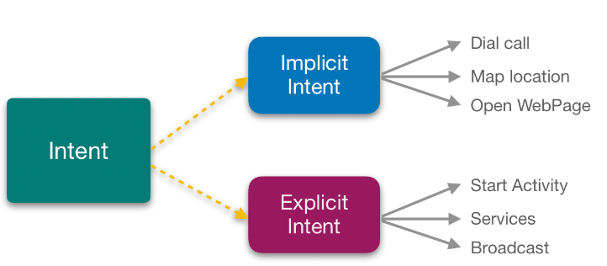
Intents-Nothing but user intentions

Slide 7
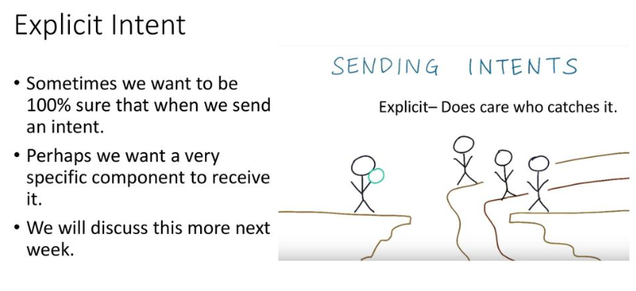

Slide 8
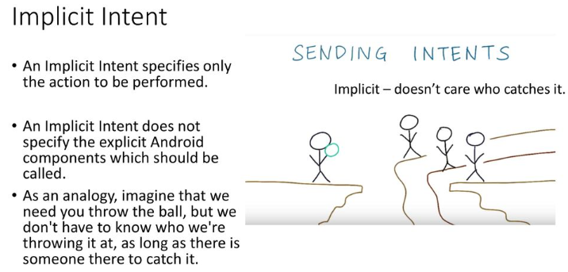

Slide 9
Services
Service is a special component that facilitates an application to run in the background in order to perform long-running operation tasks.
Examples are SQLite, Music player service, Alarm service etc.
There are several services available for Android applications we just need to know how to use them in our application.

Slide 10
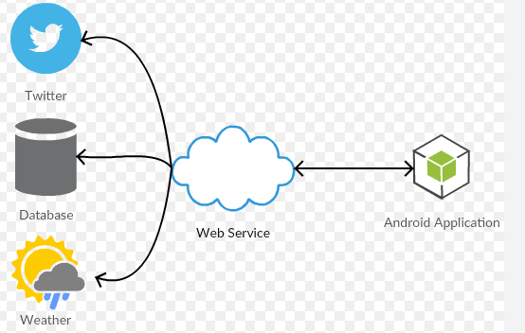
Web Services

Slide 11
Hardware Requirements
To develope an Android application or to run Android studio, we need an I5 or I7 processor with atleast 8GB RAM.

Slide 12
Learner Pre-requisites:
To understand Android, oops concepts and Java is compulasary
To understand Flutter, Dart programming and flutter frame work
To understand Flask, Python, Flask frame work, HTML and routing concepts of single page web application development.

Slide 13
Overall Lab Objectives
Android Frame work with Java
Flutter frame work and Dart
Flask frame work with Python
Firebase
This Lab will give you the knowledge of developing Mobile applications with three different frameworks and technologies.
Firebase helps you to connect database to a mobile applications.
Frameworks are more important than technologies as it gives you the basic idea of mobile app development.

